Slide 2
Drug Induced Myopathies

Slide 3
Dr. Afshin Gharekhani
PharmD, BCPS
Assistant Professor of Clinical Pharmacy,
Department of Clinical Pharmacy,
Tabriz University of Medical Sciences

Slide 4
Definition
Rhabdomyolysis is a syndrome characterized by muscle necrosis and the release of intracellular muscle constituents into the circulation.
Creatine kinase (CK) levels are typically markedly elevated, and muscle pain and myoglobinuria may be present.
The severity of illness ranges from asymptomatic elevations in serum muscle enzymes to life-threatening disease associated with extreme enzyme elevations, electrolyte imbalances, and acute kidney injury.

Slide 5
PATHOPHYSIOLOGY
The clinical manifestations and complications of rhabdomyolysis result from muscle cell death, which may be triggered by any of a variety of initiating events.
Final common pathway for injury is an increase in intracellular free ionized cytoplasmic and mitochondrial calcium:
Depletion of ATP
Direct injury and rupture of the plasma membrane
Increased intracellular calcium leads to
Activation of proteases
Increased skeletal muscle cell contractility
Mitochondrial dysfunction
Production of ROS
skeletal muscle cell death:
release of CPK and other muscle enzymes, myoglobin, and various electrolytes

Slide 6
Causes of Rhabdomyolysis

Slide 7
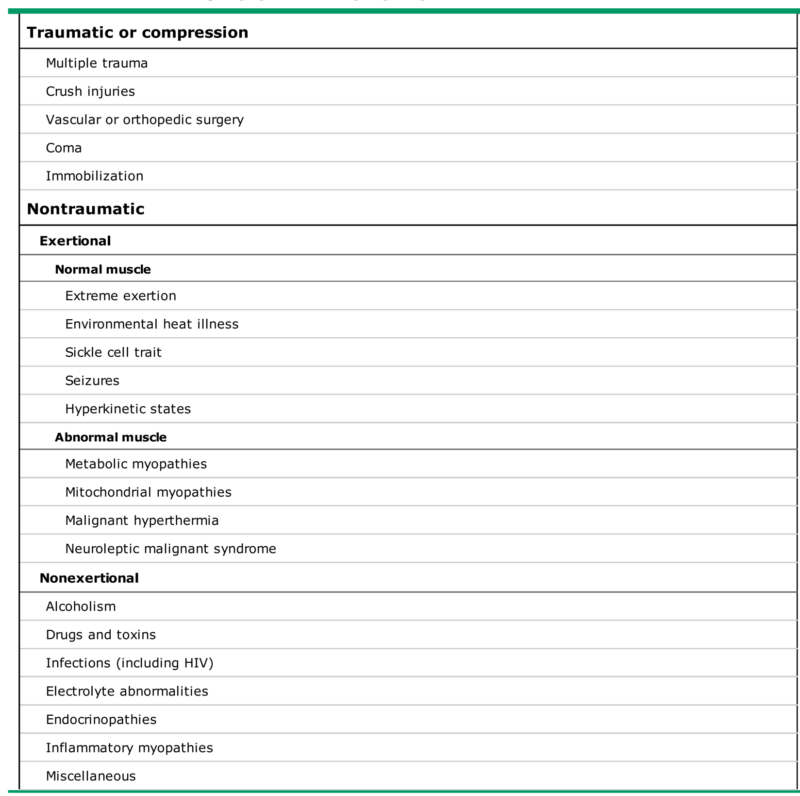

Slide 8
Drug induced Myopathies
Drug-induced myopathy is among the most common causes of muscle disease
Ranges from mild myalgias with or without mild weakness to chronic myopathy with severe weakness and to massive rhabdomyolysis with acute renal failure
Over 150 agents have been associated with rhabdomyolysis

Slide 9
Several different mechanisms for Drug induced Myopathies

Slide 10
Direct Myotoxicity
Alcohol
Acute myopathy: occurs in the setting of longstanding alcoholism, within hours after a particularly severe alcoholic binge (often one lasting several days).
Patients present with cramps, tenderness, and swelling.
Muscle involvement is usually generalized, although there is a predilection for the calf muscles.
Chronic myopathy presents with the gradual onset of diffuse, usually proximal, muscle weakness over a period of weeks to months. Diffuse muscle atrophy is common. Muscle pain and tenderness are usually absent. CPK and other muscle enzymes typically are normal or are only mildly elevated, and myoglobinuric renal failure does not occur.
Risk factors: Female alcoholics, chronic malnutrition, chronic disuse, and chronic electrolyte abnormalities.

Slide 11
Glucocorticoids
Are a common cause of drug-induced myopathy
Direct catabolic effect on skeletal muscle via effects on intermediary metabolism that provide amino acids as a substrate for gluconeogenesis.
Risk increased in older, those with cancer, negative nitrogen balance
Present with gradual onset of proximal muscle weakness, followed by atrophy of proximal muscle groups. Myalgias and muscle tenderness do not occur. Lower exteremity weakness usually occurs before upper extremity weakness and is more severe.
Difficulties in getting up from a chair, climbing stairs, or performing overhead tasks.
Myopathy is unusual in patients treated with less than 10 mg/day of prednisolone or its equivalent.
The higher the dose of glucocorticoid, the greater the likelihood of developing myopathy and the more rapid the onset of weakness. Daily doses in excess of 40-60mg/day can induce clinically important weakness within two weeks and almost always result in some degree of muscle weakness when continued for more than one month.
Myopathy is increased with fluorinated preparations such as dexamethasone and triamcinolone, compared with non-fluorinated such as prednisolone.

Slide 12
Lipid Lowering Drugs
Muscle injury due to statins, fibrates, and other lipid-lowering
Statin:
The mechanism of muscle toxicity is not well understood.
Statins decrease skeletal muscle and plasma concentrations of ubiquinone (CoQ10). CoQ10 plays an important role in muscle cell energy production.
Increased levels of plant sterols in skeletal muscle in patients treated with high-dose statins.
Induces expression of atrogin-1, a muscle-specific ubiquitin protein ligase, which may play an important role in statin toxicity
2014 National Lipid Association Statin Muscle Safety Task Force:
Myalgia – A symptom of muscle-discomfort, including muscle aches, soreness, stiffness, tenderness, or cramps with or soon after exercise, with a normal CPK level. Myalgia symptoms can be described as similar to what would be experienced with a viral syndrome such as influenza.
Myopathy – Muscle weakness (not due to pain), with or without an elevation in CPK level.
Myositis – Muscle inflammation.

Slide 13
Myonecrosis – Elevation in muscle enzymes compared with either baseline CK levels (while not on statin therapy) or the upper limit of normal that has been adjusted for age, race, and sex: • Mild – 3-fold to 10-fold elevation in CPK. • Moderate – 10-fold to 50-fold elevation in CPK. • Severe – 50-fold or greater elevation in CPK.
Clinical rhabdomyolysis – Defined by the Task Force as myonecrosis with myoglobinuria or acute renal failure (an increase in serum creatinine of least 0.5 mg/dL)
Risk Factors:
Statin characteristics
Myositis has been described in less than 0.5 percent overall, primarily occurring at higher doses.
Risk of myopathy: Fluvastatin < Pravastatin < Rosuvastatin < Atorvastatin < Simvastatin < Lovastatin
Less Drug interactions: Pravastatin, Fluvastatin, Pitavastatin, Rosuvastatin
Pre-existing neuromuscular disorders:
Motor neuronopathies (ie, Kennedy disease and amyotrophic lateral sclerosis)
Myasthenia gravis

Slide 14
Mitochondrial myopathy
McArdle disease
Acid maltase deficiency
Muscle phosphorylase b kinase deficiency
Carnitine-palmitoyl transferase deficiency
Rippling muscle disease
Myotonic dystrophy types 1 and 2
Cytoplasmic- and hyaline-body (myosin storage) myopathies
Hypothyroidism
Acute or chronic renal failure
Obstructive liver disease
Patient characteristics:
Advanced age (greater than 80 years), frailty, female sex, small body frame, acute or decompensated liver disease, and severe renal disease
Concurrent drug therapy
Those inhibit cytochrome CYP3A4, as well as with fibrates
Drug or drug class that is independently considered a risk factor for myopathy: glucocorticoids, cyclosporine, daptomycin, zidovudine

Slide 15
Simvastatin, lovastatin, and to a lesser extent atorvastatin are metabolized by CYP3A4. Fluvastatin clearance is partly dependent upon CYP2C9 metabolism whereas rosuvastatin, pitavastatin, and pravastatin are cleared primarily by non CYP-450 transformations and affected by fewer significant interactions.
An increased risk of muscle toxicity, as high as 1 to 5 percent, has been described with the administration of some statins (eg, lovastatin and atorvastatin) with gemfibrozil.
Exercise
Unaccustomed vigorous exercise in those on statins may increase the risk for muscle injury.
A graduated training program affords time for metabolic adaptation that can mitigate this risk.
Graduated physical training, which induces mitochondrial biogenesis and upregulation of antioxidant defense mechanisms, appears to protect skeletal muscle fibers from the pro-oxidant effects of statins.

Slide 16
Cocaine
Muscle injury ranging from asymptomatic CPK elevation to massive rhabdomyolysis with acute renal failure has been reported.
Direct cocaine-induced muscle injury may result from the markedly increased sympathomimetic activity induced by cocaine. Severe arterial vasoconstriction can cause skeletal muscle ischemia and infarction, also cocaine-induced vasospasm causes myocardial, cerebral, skin, or digital infarction.
An alternative mechanism: cocaine-induced inhibition of the reuptake of catecholamines at alpha adrenergic receptors, which, in turn, leads to high intracellular calcium levels in muscle cells and to subsequent cell damage and rhabdomyolysis.
Muscle injury can occur after oral or intranasal cocaine use but may be more common after IV use or after smoking the alkaloid-free base (crack cocaine) because of the more rapid and higher blood levels of the drug achieved via those routes.
Muscle injury can occur after a one-time use of the drug or after repeated use.
The onset of muscle involvement is usually within hours after drug administration.

Slide 17
Antimalarial drugs
Antimalarial drugs used in the treatment of rheumatoid arthritis and systemic lupus erythematosus have been reported to cause a toxic neuropathy, myopathy, and cardiomyopathy: chloroquine, hydroxychloroquine and amodiaquine
Duration of antimalarial therapy prior to the onset of weakness varies widely from less than one year to more than 10 years
Myopathy does not seem to relate to dose
Antimalarial neuromyopathy due to Accumulation of chloroquine or hydroxychloroquine in lysosomes and to the subsequent inhibition of lysosomal enzymes
Weakness, neurologic deficits, and congestive heart failure resolve within months after discontinuation of the antimalarial drug

Slide 18
Antipsychotic drugs
Life threatening neurologic emergency associated with the use of neuroleptic agents and characterized by a distinctive clinical syndrome of mental status change, rigidity, fever, and autonomic instability.
0.02 to 3 percent among patients taking neuroleptic agents
Most often seen with the "typical" high potency neuroleptic agents (eg, haloperidol, fluphenazine).
However, every class of neuroleptic drug has been implicated, including the low potency (eg, chlorpromazine) and the newer "atypical" antipsychotic drugs (eg, clozapine, risperidone, olanzapine) as well as antiemetic drugs (eg, metoclopramide, promethazine)
Symptoms usually develop during the first two weeks of neuroleptic therapy, the association of the syndrome with drug use is idiosyncratic. NMS can occur after a single dose or after treatment with the same agent at the same dose for many years. It is not a dose-dependent phenomenon, but higher doses are a risk factor. Case-control studies implicate recent or rapid dose escalation, a switch from one agent to another, and parenteral administration as risk factors.
Associated risk factors: use of higher doses, rapid escalation, and parenteral therapy.

Slide 19
Antiparkinson medication withdrawal
NMS is also seen in patients treated for parkinsonism in the setting of withdrawal of L-Dopa or dopamine agonist therapy, as well as with dose reductions and a switch from one agent to another.
Infection and surgery are possible precipitants as well.
Called neuroleptic malignant-like syndrome or parkinsonism hyperpyrexia syndrome as well as acute akinesia or the malignant syndrome in Parkinson disease.

Slide 20
Colchicine
Neuromyopathy with colchicine can occur in the setting of acute overdose or even in the setting of chronic administration in therapeutic doses.
The pathogenesis of colchicine neuromyopathy is unknown
Thought to be related to colchicine’s known effect on microtubule function, leading to impaired axonal transport in peripheral nerves and to alteration of the muscle cytoskeleton that is necessary for the normal movement of lysosomes in the cell.
Increased risk: Chronic kidney disease, CYP34A inhibitors including macrolide antibiotics, cyclosporin, azoles, and protease inhibitors
Typically present with proximal muscle weakness, often more prominent in the lower than upper extremities.
CPK levels are almost always elevated, usually 10-to 20-fold above normal.
Muscle weakness resolves, and CPK levels return to normal within a few days to several weeks after discontinuation of colchicine. The neuropathy resolves more slowly.

Slide 21
Antiretroviral drugs
Zidovudine and other nucleoside reverse transcriptase inhibitors can produce a mitochondrial myopathy with elevated muscle enzymes and with weakness.
The myopathy typically improves with discontinuation of the drug.

Slide 22
Ipecac
Chronic use of syrup of ipecac by patients with bulimia to cause vomiting and weight loss may cause muscle damage.
In addition to effects on skeletal muscle, cardiotoxicity has also been observed with clinical manifestations of tachycardia, hypotension, and conduction defects.

Slide 23
Chemotherapeutic agents
Chemotherapeutic agents can be associated with an acute myopathy localized to sites previously exposed to radiation
Muscle biopsies show necrosis and evidence of a vascular origin of the muscle injury. This phenomenon, termed radiation recall, is typically limited to the skin, but some agents such as gemcitabine more commonly involve muscle.
Gemcitabine may also cause an acute myopathy in patients who have not been exposed to radiation.

Slide 24
Immunologically induced inflammatory myopathy
TNF-α inhibitors: New-onset inflammatory myopathy
Interferon alpha: Myositis
Statins: necrotizing myopathy
Penicillamine: inflammatory myopathy
Use of penicillamine in patients with rheumatoid arthritis, scleroderma, cystinuria, and Wilson’s disease
No relationship either to daily dose or to the duration of penicillamine therapy
Symmetric proximal muscle weakness
Typical dermatomyositis rashes and dysphagia may also be seen
Muscle enzymes are elevated.
EMG shows myopathic changes
Muscle biopsy reveals perifascicular cellular infiltrates, as well as muscle fiber necrosis and regeneration
Muscle weakness resolves, and muscle enzymes return to normal within a few weeks to months of stopping the drug ± high-dose glucocorticoids (40 to 60 mg of prednisone per day)

Slide 25
Clinical Manifestation

Slide 26
Symptoms
The characteristic triad of complaints in rhabdomyolysis:
Muscle pain: typically most prominent in proximal muscle groups, such as the thighs and shoulders, and in the lower back and calves. Other muscle symptoms include stiffness and cramping.
Weakness
Dark urine
Additional symptoms that are more common in severely affected patients include
Malaise
Fever
Tachycardia
Nausea and vomiting
Abdominal pain
Altered mental status may occur from the underlying etiology (eg, toxins, drugs, trauma, or electrolyte abnormalities).

Slide 27
Physical Finding
Muscle tenderness and swelling may be seen, but detectable muscle swelling in the extremities generally develops, when it occurs, with fluid repletion.
Muscle weakness may be present, depending upon the severity of muscle injury.
Limb induration is occasionally present.
Skin changes of ischemic tissue injury, such as discoloration or blisters, may also be seen but are present in less than 10 percent of patients.

Slide 28
Laboratory findings
The hallmark of rhabdomyolysis is an elevation in CPK and other serum muscle enzymes. The other characteristic finding is the reddish-brown urine of myoglobinuria, but because this may be observed in only half of cases, its absence does not exclude the diagnosis.
Creatine kinase:
At presentation are usually at least five times the upper limit of normal, but range from approximately 1500 to over 100,000 international units/L
The CPK is generally entirely or almost entirely of the MM or skeletal muscle fraction
Elevations in serum aminotransferases are common and can cause confusion if attributed to liver disease
The serum CK begins to rise within 2 to 12 hours following the onset of muscle injury and reaches its maximum within 24 to 72 hours.
A decline is usually seen within three to five days of cessation of muscle injury. CK has a serum half-life of about 1.5 days and declines at a relatively constant rate of about 40 to 50 percent of the previous day’s value.
In patients whose CK does not decline as expected, continued muscle injury or the development of a compartment syndrome may be present.

Slide 29
Urine findings and myoglobinuria
Myoglobin, a heme-containing respiratory protein, is released from damaged muscle in parallel with CPK.
Myoglobin is a monomer that is not significantly protein-bound and is therefore rapidly excreted in the urine, often resulting in the production of red to brown urine.
It appears in the urine when the plasma concentration exceeds 1.5 mg/dL. Visible changes in the urine only occur once urine levels exceed from about 100 to 300 mg/dL, although it can be detected by the urine dipstick at concentrations of only 0.5 to 1 mg/dL.
Myoglobin has a half-life of only two to three hours, much shorter than that of CK.
Because of its rapid excretion and metabolism to bilirubin, serum levels may return to normal within six to eight hours.
Thus, it is not unusual for CK levels to remain elevated in the absence of myoglobinuria.
Routine urine testing for myoglobin by urine dipstick evaluation may be negative in up to half of patients with rhabdomyolysis.
Pigmenturia will be missed in rhabdomyolysis if the filtered load of myoglobin is insufficient or has largely resolved before the patient seeks medical attention due to its rapid clearance.

Slide 30
Both hemoglobin and myoglobin can be detected on the urine dipstick as “blood”; microscopic evaluation of the urine generally shows few RBC (less than five per high-powered field) in patients with rhabdomyolysis whose positive test results from myoglobinuria.
Proteinuria may also be seen, due to the release of myoglobin and other proteins by the damaged myocytes.

Slide 31
Other manifestations

Slide 32
Fluid and electrolyte abnormalities
Hypovolemia: results from “third-spacing” due to the influx of extracellular fluid into injured muscles and increases the risk of acute kidney injury.
Hyperkalemia and hyperphosphatemia: result from the release of potassium and phosphorus from damaged muscle cells. Hyperkalemia is more common in patients with oliguric acute kidney injury.
Hypocalcemia: can be extreme, occurs in the first few days because of entry into damaged myocytes and both deposition of calcium salts in damaged muscle and decreased bone responsiveness to PTH. During the recovery phase, serum calcium levels return to normal and may rebound to significantly elevated levels due to the release of calcium from injured muscle, mild secondary hyperparathyroidism from the acute renal failure, and an increase in calcitriol.
Severe hyperuricemia: may develop because of the release of purines from damaged muscle cells and, if acute kidney injury occurs, reduced urinary excretion.
Metabolic acidosis: is common, and an increased anion gap may be present.

Slide 33
Acute Kidney Injury
A common complication of rhabdomyolysis. The reported frequency of AKI ranges from 15 to over 50 percent.
The risk of AKI is lower in patients with CPK levels at admission less than 15 to 20,000 units/L; risk factors for AKI in patients with lower values include dehydration, sepsis, and acidosis.
Volume depletion resulting in renal ischemia,
Tubular obstruction due to heme pigment casts
Tubular injury from free chelatable iron.
Reddish-gold pigmented casts are often observed in the urine sediment.
Contribute to AKI

Slide 34
Compartment syndrome
A compartment syndrome exists when increased pressure in a closed anatomic space threatens the viability of the muscles and nerves within the compartment.
Compartment syndrome is a potential complication of severe rhabdomyolysis that may develop after fluid resuscitation, with worsening edema of the limb and muscle.
Lower extremity compartment syndrome can also be a cause of rhabdomyolysis, as may occur after tibial fractures.

Slide 35
Disseminated intravascular coagulation
Infrequently, severe rhabdomyolysis may be associated with the development of disseminated intravascular coagulation due to the release of thromboplastin and other prothrombotic substances from the damaged muscle

Slide 36
Evaluation and Diagnosis

Slide 37
Indications for diagnostic testing:
Both myalgias and pigmenturia.
Either myalgias or pigmenturia, with a history suggesting the presence or recent exposure to a potential cause or event.
The absence of myalgias or pigmenturia in a clinical setting associated with increased risk for rhabdomyolysis. The diagnosis should be suspected following prolonged immobilization, in any stuporous or comatose patient or in a patient who is otherwise unable to provide a medical history and has one or more of the following:
Muscle tenderness
Evidence of pressure necrosis of the skin
Signs of multiple trauma or a crush injury
Blood chemistry abnormalities suggesting the possibility of increased cell breakdown, such as hyperkalemia, hyperphosphatemia, and /or hypocalcemia
Evidence of acute kidney injury

Slide 38
Diagnostic evaluation
CPK – Fractionation of the CPK is generally not required but may be helpful, in addition to the clinical history and examination, in excluding other potential causes of CPK elevation such as acute MI, stroke, and other diseases of the heart and brain. Other muscle enzymes in addition to CPK are typically elevated (eg, aldolase, aminotransferases, LDH), but such testing is not usually necessary to make the diagnosis.
Urinalysis including dipstick and microscopic evaluation: Evidence of myoglobinuria should be sought by routine urine dipstick evaluation combined with microscopic examination
Additional tests for help in differential diagnosis
Complete blood count, including differential and platelet count
Blood urea nitrogen, creatinine, and routine electrolytes including potassium
Calcium, phosphate, albumin, and uric acid
Electrocardiography
screening for drugs of abuse, depends upon the clinical context

Slide 39
Diagnosis
We make the diagnosis of rhabdomyolysis in a patient with either an acute neuromuscular illness or dark urine without other symptoms, plus a marked acute elevation in serum CPK.
The CPK is typically at least five times the upper limit of normal, and is usually greater than 5000 international units/L.
No absolute cut-off value for CPK elevation can be defined, and the CPK should be considered in the clinical context of the history and examination findings.
Additional testing, such as EMG, MRI, and muscle biopsy, is not required for the diagnosis of rhabdomyolysis. These studies are generally reserved for patients in whom an underlying inflammatory myopathy is suspected.

Slide 40
Differential Diagnosis:
Myocardial infarction
Hematuria and hemoglobinuria
Inflammatory myopathy
Immune-mediated necrotizing myopathy
Renal colic

Slide 41
Prevention and treatment

Slide 42
Prevention
In addition to treating the underlying rhabdomyolysis or hemolysis, the general goals for preventive therapy in all patients at risk for heme pigment-induced AKI are:
Correction of volume depletion if present
Prevention of intratubular cast formation

Slide 43
Volume administration:
The prevention of AKI requires early and aggressive fluid resuscitation. The goals of volume repletion are to maintain or enhance renal perfusion, thereby minimizing ischemic injury, and to increase the urine flow rate, which will limit intratubular cast formation, wash out partially obstructing intratubular casts, and increase urinary potassium excretion.
Intravenous isotonic saline should be administered as soon as possible after the onset of injury or detection of hemolysis and continued until the muscle injury or hemolysis has resolved.
Total amount and rate of volume repletion will vary depending on the underlying cause of rhabdomyolysis and hemolysis.
For patients who are at risk for heme-associated AKI due to rhabdomyolysis from any cause, initial fluid resuscitation with isotonic saline at a rate of 1 to 2 L/hour should be initiated. The CPK concentration correlates with the severity of muscle injury, and concentrations >5000 unit/L identify patients who are at risk for the development of AKI. However, it may be difficult to identify patients who are at high risk for AKI based upon the initial plasma CPK value since the CPK level may still be rising from ongoing muscle injury.

Slide 44
Vigorous fluid repletion continues until it is clear from sequential laboratory values that the plasma CPK level is stable and not increasing (CPK level <5000 unit/L) and urine is dipstick negative for hematuria.
If a diuresis is established, fluids are titrated to maintain a urine output of 200 to 300 mL/hour.
Bicarbonate
Administer a bicarbonate infusion to patients who have severe rhabdomyolysis, such as those with a serum CPK above 5000 unit/L or clinical evidence of severe muscle injury (eg, crush injury) and a rising serum CPK, regardless of the initial value. The following conditions should be met:
Severe hypocalcemia is not present
Arterial pH is less than 7.5
Serum bicarbonate is less 30 mEq/L

Slide 45
We infuse approximately 130 mEq/L of sodium bicarbonate (150 mL [3 amps] of 8.4 percent sodium bicarbonate mixed with 1 L of 5 percent dextrose or water) via an intravenous line separate from that used for the isotonic saline infusion. The initial rate of infusion is 200 mL/hour; the rate is adjusted to achieve a urine pH of >6.5.
If bicarbonate is given, the arterial pH and serum calcium should be monitored every two hours during the infusion. The bicarbonate infusion should be discontinued if the urine pH does not rise above 6.5 after 3-4hours, if the patient develops symptomatic hypocalcemia, if the arterial pH exceeds 7.5, or if the serum bicarbonate exceeds 30 mEq/L. If the bicarbonate solution is discontinued, volume repletion should be continued with isotonic saline.

Slide 46
Loop diuretics and mannitol
The benefit of loop diuretics or mannitol in rhabdomyolysis is not established.
Judicious use of loop diuretics may be justified in patients with rhabdomyolysis or hemolysis if there is evidence of volume overload
Patients who remain oliguric or anuric despite aggressive volume resuscitation should be considered to have established AKI. Among such patients, the rate of fluid administration should be decreased to a rate sufficient to maintain circulatory support. Such patients should be closely followed for indications to initiate dialysis.
Dialysis
The use of dialysis to remove myoglobin, hemoglobin, or uric acid in order to prevent the development of renal injury has not been demonstrated.

Slide 47
Treatment
Treatment of metabolic abnormalities
Hyperkalemia should be anticipated and may occur even in the absence of severe renal failure. Hyperkalemia should be aggressively treated. Dialysis may be required to treat severe hyperkalemia.
To minimize the late occurrence of hypercalcemia, calcium supplementation for hypocalcemia should be avoided unless significant signs and symptoms of hypocalcemia develop or calcium administration is required for the management of hyperkalemia.
Patients who develop hyperuricemia should be treated with allopurinol. Allopurinol should be given orally at 300mg if uric acid levels are >8 mg/dL or if there is a 25 percent increase from baseline.

Slide 48
Treatment of established AKI
Other than maintenance of fluid and electrolyte balance and tissue perfusion, there is no specific therapy once the patient has developed AKI. The initiation of dialysis may be necessary for control of volume overload, hyperkalemia, severe acidemia, and uremia.

Slide 49
Thanks…

